Slide 1
Data Mining Classification: Alternative Techniques
Lecture Notes for Chapter 5
Introduction to Data Mining
by
Tan, Steinbach, Kumar
© Tan,Steinbach, Kumar Introduction to Data Mining 4/18/2004 1

Slide 2
Classification Overview
Assigning data to discrete categories
Notes:
When you classify something, you first define a set of discrete categories: what are the possible classifications a new data instance can take? If you’re classifying spam, then you are simply creating a binary classifier: possible categories are “spam” and “not spam”. If you’re running a packet sniffer on a network and attempting to classify the packets you observe crisscrossing the network, you may have three possible categories: “Linux”, “Windows”, and “OS X.” Or you may add in more, since you’re Carnegie Mellon students and your networks (and probably your computers) will have operating systems that fall into other categories, such as “Solaris” or “BSD”, though you could create a fourth category that is simply “Other”.

Slide 3

Classification Overview
Assigning data to discrete categories
Train a model on labeled data
Spam
Not spam
Notes:
Once you have your categories, you must first train your model to recognize the properties that distinguish data between the different categories. This involves feeding your model data instances which are already labeled. In our examples, this would mean providing emails which you know for a fact are either spam or not spam, and informing your model as to which it is. For our operating system example, this would involve feeding the model packets with the operating system label attached: Linux, OS X, Windows, or Other. With enough training instances, your model will tune into the properties of the instances that classify it into one of your categories.

Slide 4
Classification Overview
?
Assigning data to discrete categories
Train a model on labeled data
Run the model on new, unlabeled data
Spam
Not spam
Notes:
The trained classifier is now ready to be put into the real world. This entails looking at new observations that do not have labels attached: reading new incoming emails and trying to determine whether or they are spam, or examining packets in real time as they crisscross the network and attempting to discern from what operating system they originated (nmap or wireshark, anyone?).

Slide 5
Example
Not spam
Notes:
Here we have three emails. They’re each labeled “not spam”, because we know for a fact that they are not spam, and we want our model to analyze them for any properties that will definitively identify them as such.

Slide 6

Example
Not spam
President Obama’s Nobel Prize Speech
Notes:
In this specific case, they are, in fact, excerpts from President Obama’s Nobel Prize acceptance speech (taken from the dataset on Many Eyes). Obviously this is somewhat contrived, but you can imagine what a distribution of words might look like from legitimate emails, particularly one from a speechwriter on one specific topic. Our model then associates the words in these emails with the category “not spam”.

Slide 7
Example
Spam
Notes:
Now we train our model on three negative examples: emails that we have definitively identified as “spam”, either through manual inspection or some other means.

Slide 8

Example
Spam
Spam email content
Notes:
The distribution of words looks something like this (also a dataset taken from Many Eyes, specifically a spam email dataset), and our model associates these words with the “spam” label. You can imagine many common words overlap between the two categories: some optimizations will take the step of actually throwing common words out, but for the most part it will be the collection of all these words together that yields the final classification.

Slide 9
Example
Notes:
Now we have a trained model, and a new email comes in. How do we label it?

Slide 10
Example
“Order a trial Adobe chicken daily
EAB-List new summer savings, welcome!”
Notes:
If we decompose it into its constituent tokens and get something like this, our classifier will then examine the distributions of these words and come up with a probability for each label. You can probably guess which category this would fall into: judging from the two word clouds, this would most likely be classified as “spam” and would never see the light of our inbox.

Slide 11
Instance-Based Classifiers
Store the training records
Use training records to predict the class label of unseen cases

Slide 12
Instance Based Classifiers
Examples:
Rote-learner
Memorizes entire training data and performs classification only if attributes of record match one of the training examples exactly
Nearest neighbor
Uses k “closest” points (nearest neighbors) for performing classification

Slide 13
Nearest Neighbor Classifiers
Basic idea:
If it walks like a duck, quacks like a duck, then it’s probably a duck
Compute Distance
Test Record
Training Records
Choose k of the “nearest” records

Slide 14
Nearest-Neighbor Classifiers
Requires three things
The set of stored records
Distance Metric to compute distance between records
The value of k, the number of nearest neighbors to retrieve
To classify an unknown record:
Compute distance to other training records
Identify k nearest neighbors
Use class labels of nearest neighbors to determine the class label of unknown record (e.g., by taking majority vote)

Slide 15
Definition of Nearest Neighbor
K-nearest neighbors of a record x are data points that have the k smallest distance to x

Slide 16
Nearest Neighbor Classification
Compute distance between two points:
Euclidean distance
Determine the class from nearest neighbor list
take the majority vote of class labels among the k-nearest neighbors
Weigh the vote according to distance
weight factor, w = 1/d²

Slide 17
Nearest Neighbor Classification…
Choosing the value of k:
If k is too small, sensitive to noise points
If k is too large, neighborhood may include points from other classes

Slide 18
Nearest Neighbor Classification…
Scaling issues
Attributes may have to be scaled to prevent distance measures from being dominated by one of the attributes
Example:
height of a person may vary from 1.5m to 1.8m
weight of a person may vary from 90lb to 300lb
income of a person may vary from $10K to $1M

Slide 19
Nearest Neighbor Classification…
Problem with Euclidean measure:
High dimensional data
curse of dimensionality
Can produce counter-intuitive results
1 1 1 1 1 1 1 1 1 1 1 0
1 0 0 0 0 0 0 0 0 0 0 0
vs
0 1 1 1 1 1 1 1 1 1 1 1
0 0 0 0 0 0 0 0 0 0 0 1
d = 1.4142
d = 1.4142
Solution: Normalize the vectors to unit length

Slide 20
Nearest neighbor Classification…
k-NN classifiers are lazy learners
It does not build models explicitly
Unlike eager learners such as decision tree induction and rule-based systems
Classifying unknown records are relatively expensive

Slide 21
Bayes Classifier
A probabilistic framework for solving classification problems
Conditional Probability:
Bayes theorem:

Slide 22
Example of Bayes Theorem
Given:
A doctor knows that meningitis causes stiff neck 50% of the time
Prior probability of any patient having meningitis is 1/50,000
Prior probability of any patient having stiff neck is 1/20
If a patient has stiff neck, what’s the probability he/she has meningitis?

Slide 23
Bayesian Classifiers
Consider each attribute and class label as random variables
Given a record with attributes (A₁, A₂,…,A_{n})
Goal is to predict class C
Specifically, we want to find the value of C that maximizes P(C| A₁, A₂,…,A_{n} )
Can we estimate P(C| A₁, A₂,…,A_{n} ) directly from data?

Slide 24
Bayesian Classifiers
Approach:
compute the posterior probability P(C | A₁, A₂, …, A_{n}) for all values of C using the Bayes theorem
Choose value of C that maximizes P(C | A₁, A₂, …, A_{n})
Equivalent to choosing value of C that maximizes P(A₁, A₂, …, A_{n}|C) P(C)
How to estimate P(A₁, A₂, …, A_{n} | C )?

Slide 25
Naïve Bayes Classifier
Assume independence among attributes A_{i} when class is given:
P(A₁, A₂, …, A_{n} | C_{j}) = P(A₁| C_{j}) P(A₂| C_{j})… P(A_{n}| C_{j})
Can estimate P(A_{i}| C_{j}) for all A_{i} and C_{j}.
New point is classified to C_{j} if P(C_{j}) Π P(A_{i}| C_{j}) is maximal.

Slide 26
How to Estimate Probabilities from Data?
Class: P(C) = N_{c}/N
e.g., P(No) = 7/10, P(Yes) = 3/10
For discrete attributes: P(A_{i} | C_{k}) = |A_{ik}|/ N_{c}
where |A_{ik}| is number of instances having attribute A_{i} and belongs to class C_{k}
Examples:
P(Status=Married|No) = 4/7 P(Refund=Yes|Yes)=0
k

Slide 27
How to Estimate Probabilities from Data?
For continuous attributes:
Discretize the range into bins
one ordinal attribute per bin
violates independence assumption
Two-way split: (A < v) or (A > v)
choose only one of the two splits as new attribute
Probability density estimation:
Assume attribute follows a normal distribution
Use data to estimate parameters of distribution (e.g., mean and standard deviation)
Once probability distribution is known, can use it to estimate the conditional probability P(A_{i}|c)
k

Slide 28
How to Estimate Probabilities from Data?
Normal distribution:
One for each (A_{i},c_{i}) pair
For (Income, Class=No):
If Class=No
sample mean = 110
sample variance = 2975

Slide 29
Example of Naïve Bayes Classifier
Given a Test Record:
P(X|Class=No) = P(Refund=No|Class=No) × P(Married| Class=No) × P(Income=120K| Class=No) = 4/7 × 4/7 × 0.0072 = 0.0024
P(X|Class=Yes) = P(Refund=No| Class=Yes) × P(Married| Class=Yes) × P(Income=120K| Class=Yes) = 1 × 0 × 1.2 × 10⁻⁹ = 0
Since P(X|No)P(No) > P(X|Yes)P(Yes)
Therefore P(No|X) > P(Yes|X) => Class = No

Slide 30
Naïve Bayes Classifier
If one of the conditional probability is zero, then the entire expression becomes zero
Probability estimation:
c: number of classes
p: prior probability
m: parameter

Slide 31
Example of Naïve Bayes Classifier
A: attributes
M: mammals
N: non-mammals
P(A|M)P(M) > P(A|N)P(N)
=> Mammals

Slide 32
Naïve Bayes (Summary)
Robust to isolated noise points
Handle missing values by ignoring the instance during probability estimate calculations
Robust to irrelevant attributes
Independence assumption may not hold for some attributes
Use other techniques such as Bayesian Belief Networks (BBN)

Slide 33
Ensemble Methods
Construct a set of classifiers from the training data
Predict class label of previously unseen records by aggregating predictions made by multiple classifiers

Slide 34
General Idea

Slide 35
Why does it work?
Suppose there are 25 base classifiers
Each classifier has error rate, ε = 0.35
Assume classifiers are independent
Probability that the ensemble classifier makes a wrong prediction:

Slide 36
Examples of Ensemble Methods
How to generate an ensemble of classifiers?
Bagging
Boosting

Slide 37
Bagging
Sampling with replacement
Build classifier on each bootstrap sample
Each sample has probability 1- (1 – 1/n)^{n} of being selected

Slide 38
Boosting
An iterative procedure to adaptively change distribution of training data by focusing more on previously misclassified records
Initially, all N records are assigned equal weights
Unlike bagging, weights may change at the end of boosting round

Slide 39
Boosting
Records that are wrongly classified will have their weights increased
Records that are classified correctly will have their weights decreased
Example 4 is hard to classify
Its weight is increased, therefore it is more likely to be chosen again in subsequent rounds

Slide 40
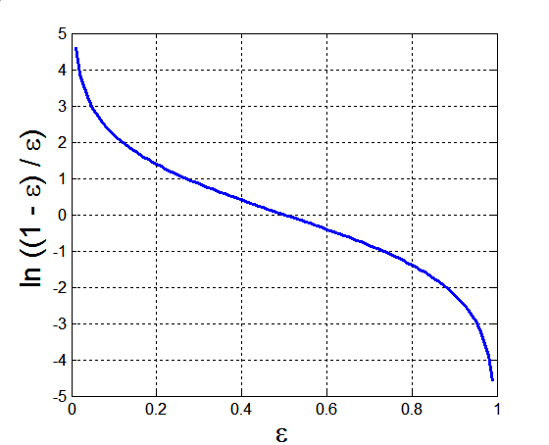
Example: AdaBoost
Base classifiers: C₁, C₂, …, C_{T}
Error rate:
Importance of a classifier:

Slide 41
Example: AdaBoost
Weight update:
If any intermediate rounds produce error rate higher than 50%, the weights are reverted back to 1/n and the resampling procedure is repeated
Classification:

Slide 42
Some Slides Taken from MIS class, UT Dallas

Slide 43
When is Bootstrapping Not Applicable?
Small datasets
The original sample is not a good approximation of the population
Dirty data
Outliers add variability in our estimates
Dependence structures (e.g., time series)
Bootstrap is based on the assumption of independence

Slide 44
Bagging
Acronym of ‘bootstrap aggregating’ (Breiman, 1996)
Ensemble Method
If the classifiers make independent errors, then their ensemble can improve performance
That is, the variance in the prediction is reduced
Bagging is less susceptible to model overfitting when applied to noisy data.

Slide 45
Bagging Observations
Bagging works well for “unstable” learning algorithms.
Bagging can slightly degrade the performance of “stable” learning algorithms.
What are “unstable” learning algorithms?
Small changes in training data result in large changes in predictions.
Neural networks
Decision trees
Regression trees
Stable learning algorithms:
k-NN

Slide 46
Boosting
Train classifiers (e.g. decision trees) in a sequence.
In each step, cases which were incorrectly classified in the previous round receive more weight in training.
I.e., a new classifier focuses more on previously incorrectly classified cases.
How to give more weight to such cases?
Resample more of such cases (most popular approach)
Increase the misclassification cost of such cases
Combine the classifiers by letting them vote (usually with weight) on the final prediction (like weighted bagging).
Classifiers that obtain lower training error rate have higher weight.
Each classifier could be (should be) very “weak”.

Slide 47
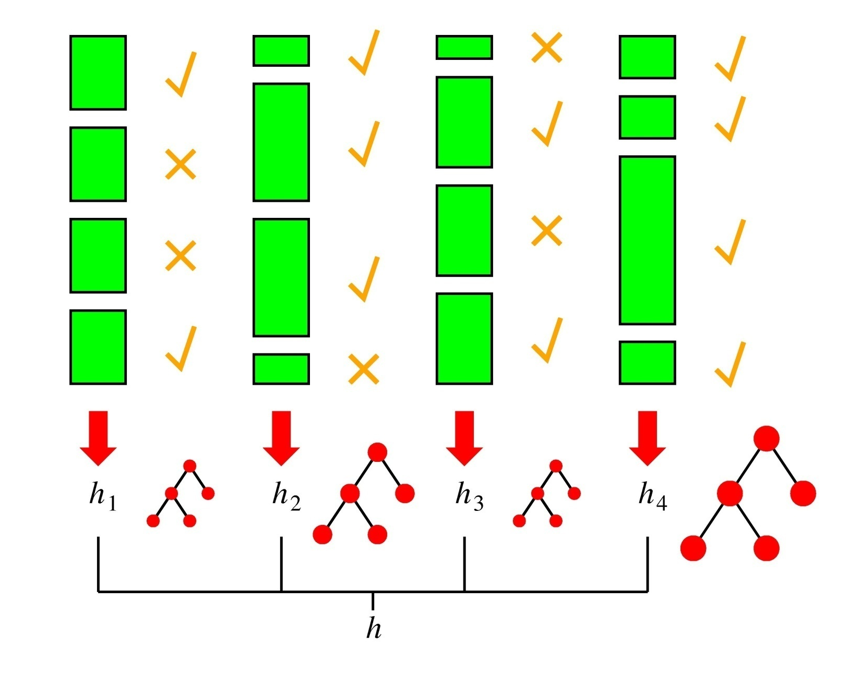
Boosting in a Picture
boosting rounds
training cases
correctly
classified
training case
has large weight
in this round
this DT has
a strong vote.

Slide 48
Boosting Intuition
Bagging gives each model equal weight. In contrast, boosting uses weighted votes (or weighted averages)
Successful models are given higher weights.
Boosting encourages new models to become experts particularly for examples that are incorrectly handled by old models.
Under bagging , classifiers are trained in parallel ; under boosting, they are trained sequentially
Why?
For better results, each classifier could be (should be) very “weak”.

Slide 49
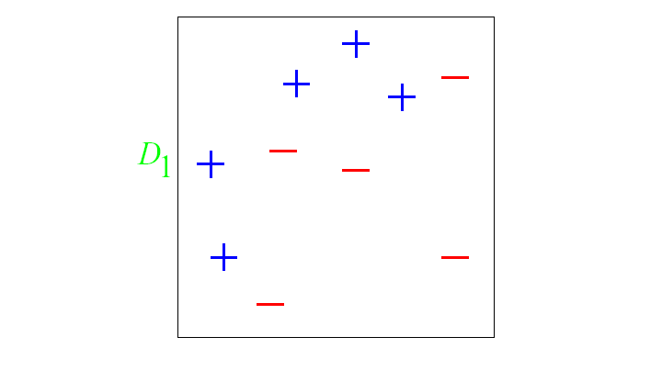
Boosting: A Pictorial Example
Original Training set : Equal Weights to all training samples
Taken from “A Tutorial on Boosting” by Yoav Freund and Rob Schapire

Slide 50
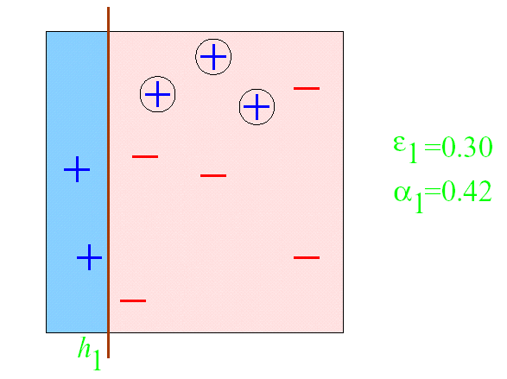
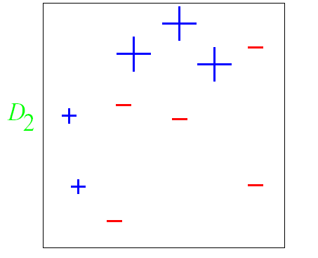
Round 1

Slide 51
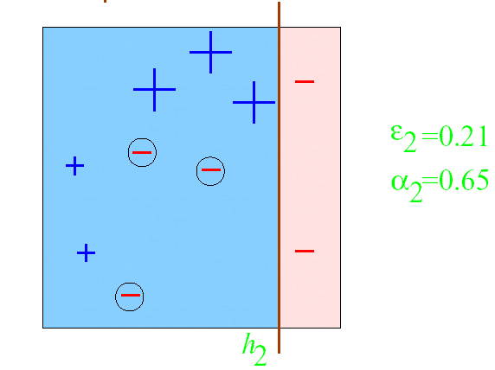
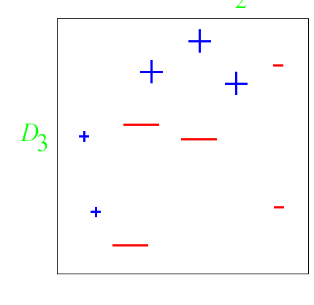
Round 2

Slide 52
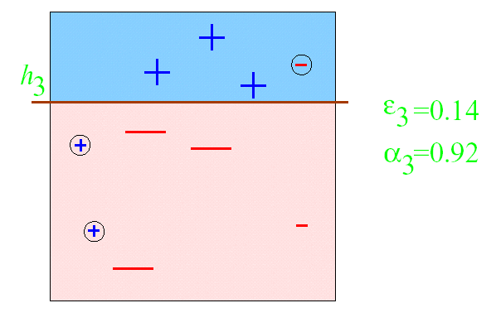
Round 3

Slide 53
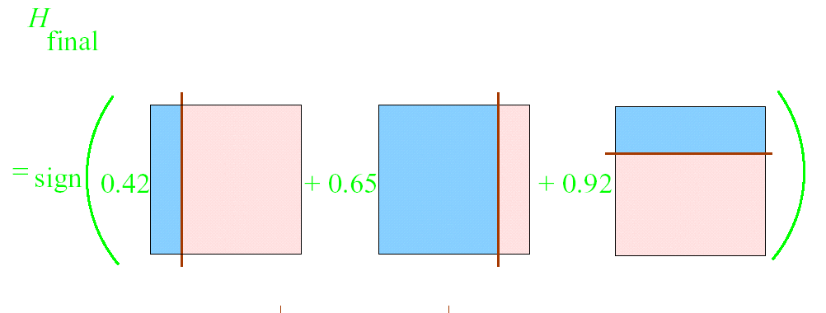
Final Classifier

Slide 54
Illustrating AdaBoost
Initial weights for each data point
Data points for training

Slide 55
Illustrating AdaBoost

